Slide 1


DATA SCIENCE JOB SALARIES ANALYSIS
Hafsat Morenigbade

Slide 2


INTRODUCTION
Data science jobs, witnessing a 650% rise since 2012, are highly in-demand. By 2026, a further 27.9% growth is expected, potentially leading to a significant shortage of data professionals in the U.S.
With this increasing demand, data scientist salaries have escalated, allowing for easy global relocation.
LETS GET STARTED

Slide 3



EXPLORATORY DATA ANALYSIS
Through Exploratory Data Analysis (EDA), we've examined the structure of our data, identified key variables, outliers, and tested assumptions.
This has provided critical insights, guiding our choice of models for further analysis and ensuring our data is ready for more detailed investigation and reliable results

Slide 4

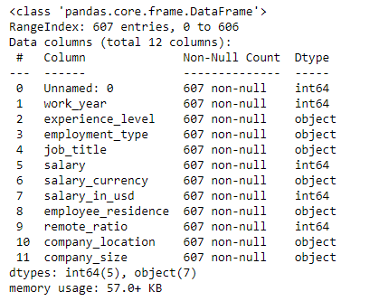
DATASET DESCRIPTION

Slide 5
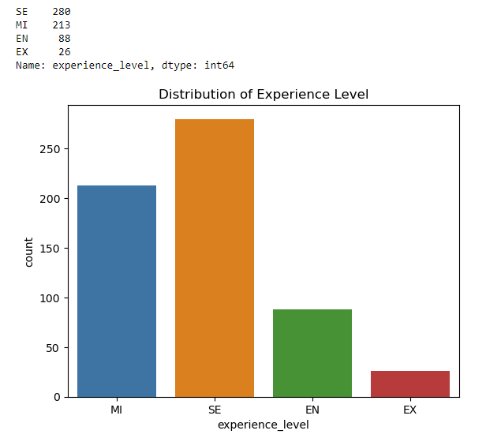
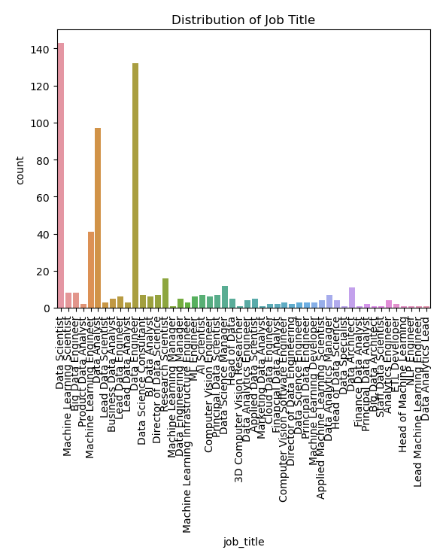
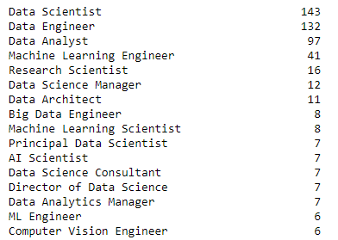
EXPERIENCE LEVEL
JOB TITLE
UNIVARIATE ANALYSIS

Slide 6
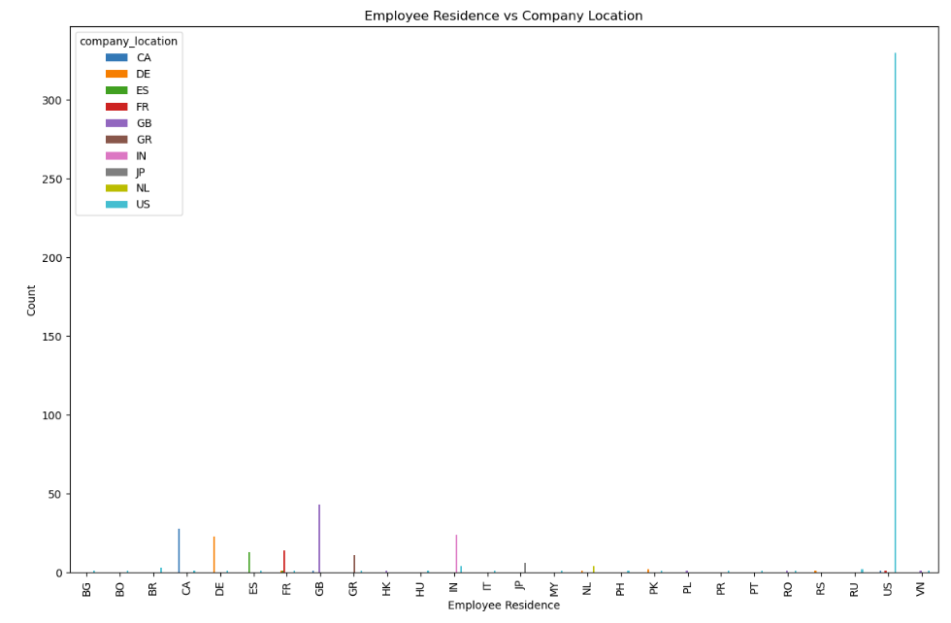
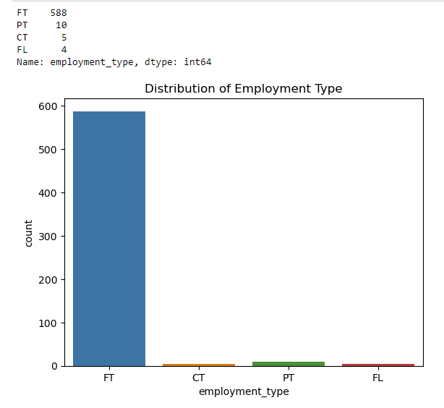
EMPLOYEE RESIDENCE & COMPANY LOCATION
EMPLOYMENT TYPE
UNIVARIATE ANALYSIS

Slide 7
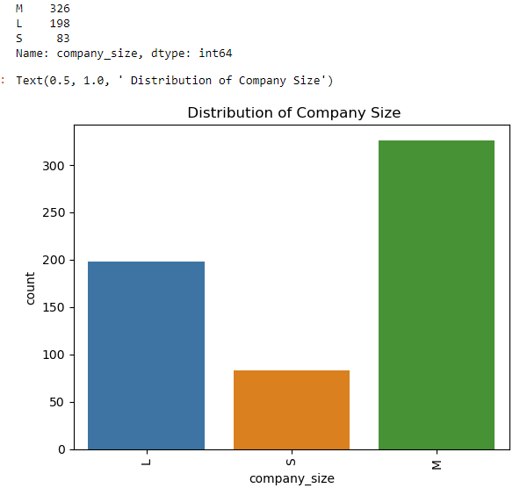
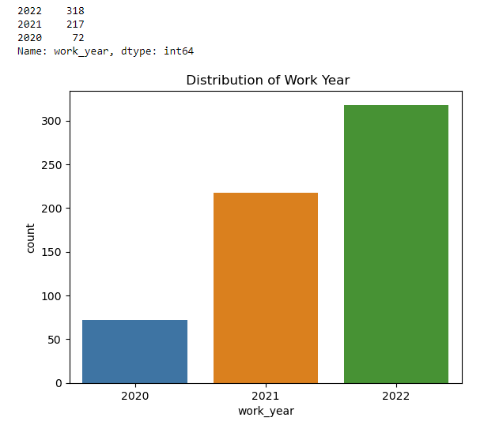
COMPANY SIZE
WORK YEAR
UNIVARIATE ANALYSIS

Slide 8
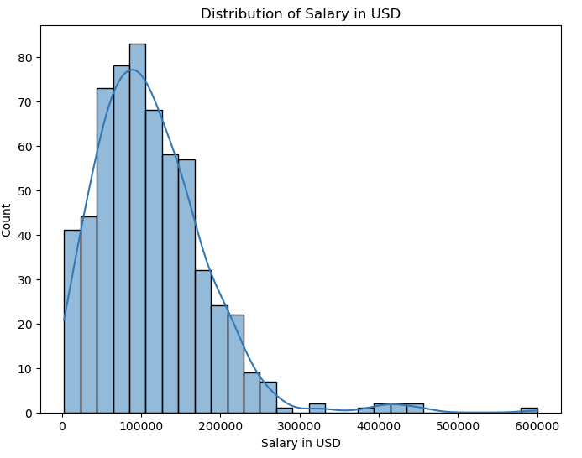
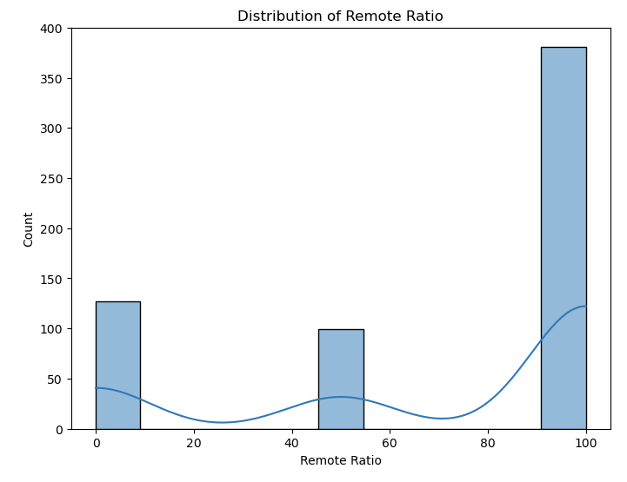
SALARY IN USD
REMOTE RATIO
UNIVARIATE ANALYSIS

Slide 9
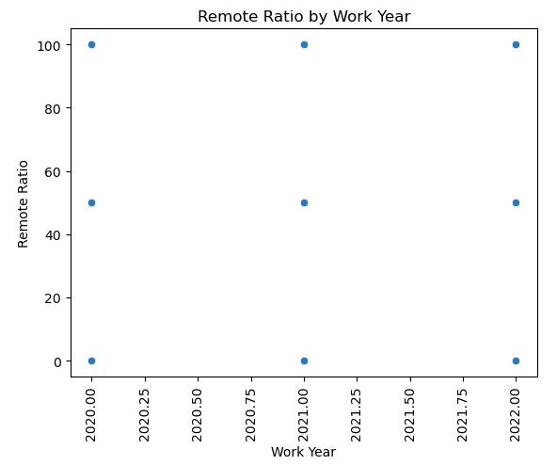
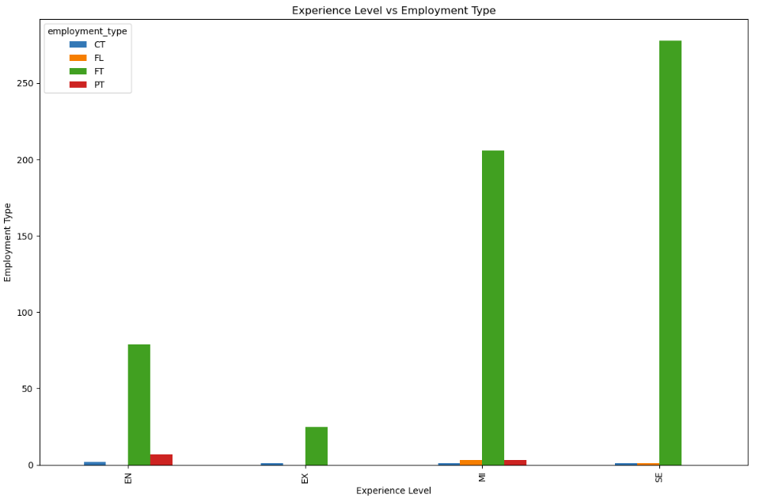
BIVARIATE
ANALYSIS
WORK YEAR ANALYSIS
EXPERIENCE LEVEL ANALYSIS

Slide 10
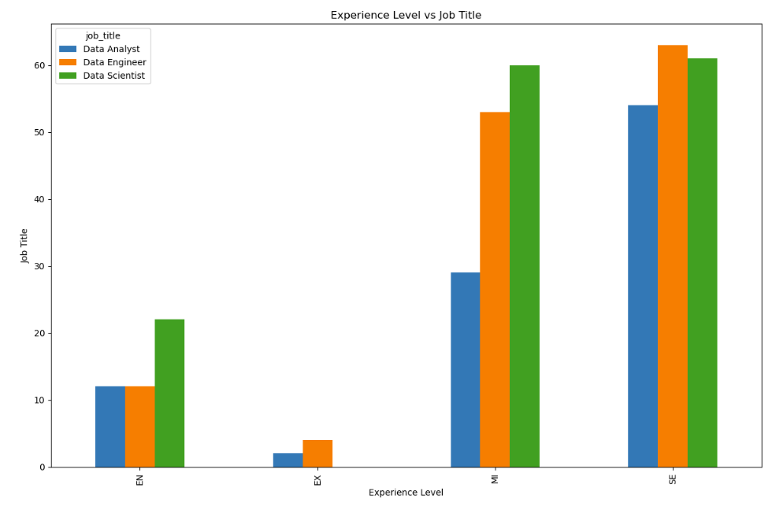
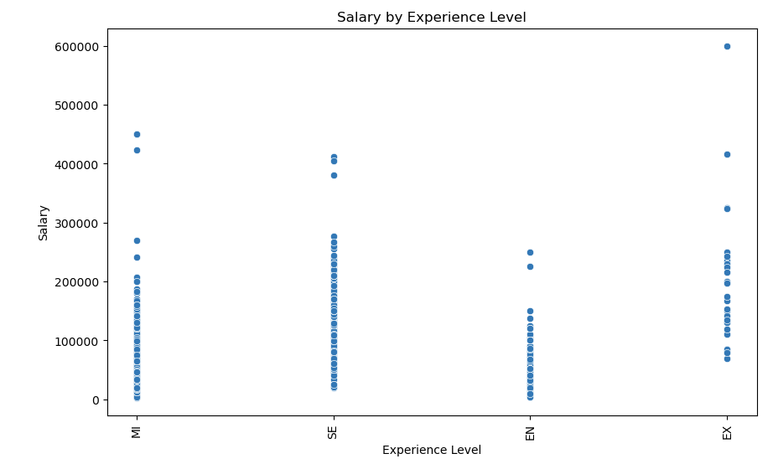
BIVARIATE
ANALYSIS
EXPERIENCE LEVEL VS JOB TITLE
SALARY BY EXPERIENCE LEVEL

Slide 11
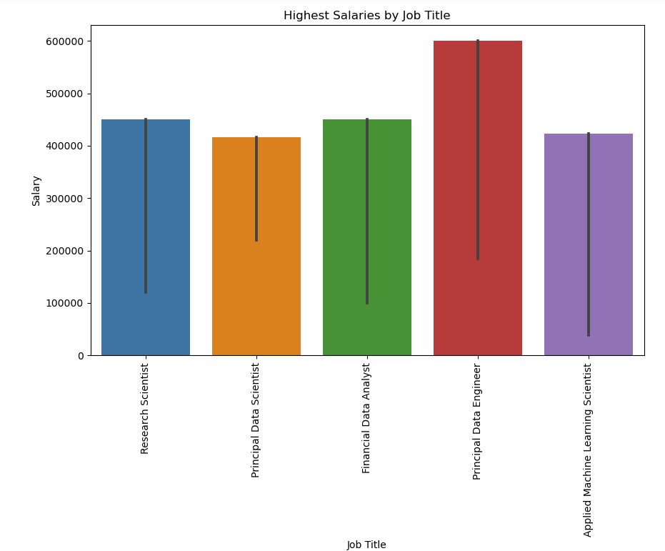
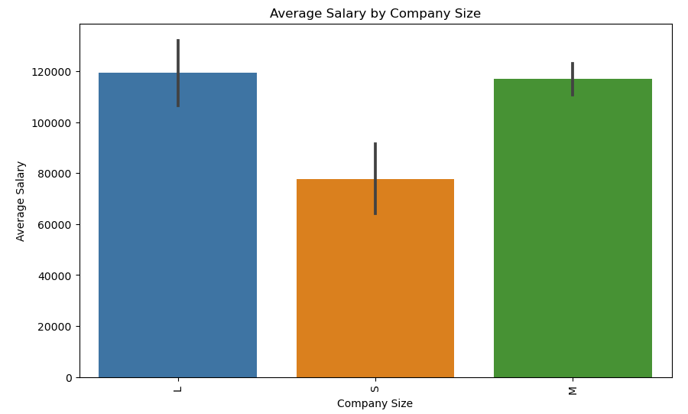
BIVARIATE
ANALYSIS
SALARY BY COMPANY SIZE
HIGHEST SALARIES BY JOB TITLE

Slide 12
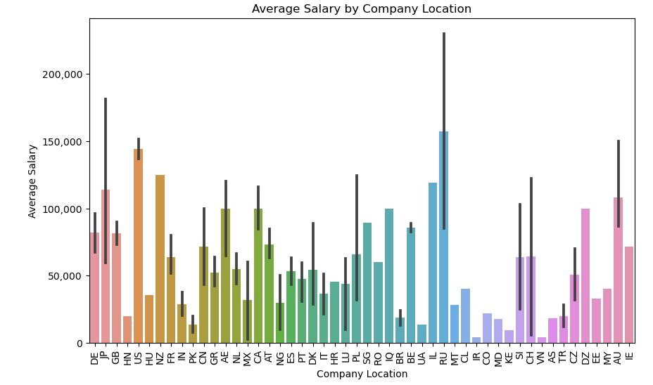
BIVARIATE
ANALYSIS
AVERAGE SALARY BY COMPANY LOCATION

Slide 13
SUMMARY
THE ANALYSIS PROVIDES INSIGHTS INTO THE THRIVING FIELD OF DATA SCIENCE, A PROFESSION WITNESSING HIGH DEMAND, INCREASED SALARIES, AND EASE OF RELOCATION. THE DATASET REVEALED THAT A MAJORITY OF DATA SCIENTISTS ARE EXPERTS IN THEIR FIELD, BASED IN THE US, AND ARE FULL-TIME WORKERS, PREDOMINANTLY IN MEDIUM-SIZED COMPANIES. MOST COMMON SALARY STANDS AT $100,000, WITH A TREND OF INCREASING REMOTE WORK. BIVARIATE ANALYSIS SHOWCASED DIVERSE REMOTE WORK ARRANGEMENTS ACROSS ALL WORK YEARS, WITH A HIGHER CONCENTRATION OF FULL-TIME ROLES AT SENIOR LEVELS. SALARIES ARE HIGHEST AT THE DIRECTOR LEVEL AND LARGER COMPANIES, WITH RUSSIA, JAPAN, AND THE US LEADING IN AVERAGE SALARIES BY LOCATION.

Slide 14
THANK YOU

